Slide 1
Discrete Mathematics R204GA05401
Narasimhulu M_{M. Tech.}
Assistant Professor
Department of Computer Science & Engineering

Slide 2
Objectives
Narasimhulu M_{M. Tech.}
Assistant Professor
Department of Computer Science & Engineering

Slide 3
Objectives
This course will introduce and illustrate in the elementary discrete mathematics for computer science and engineering students.
To equip the students with standard concepts like formal logic notation, methods of proof, induction, sets, relations, graph theory, permutations and combinations, counting principles.

Slide 4
Course Outcomes
Narasimhulu M_{M. Tech.}
Assistant Professor
Department of Computer Science & Engineering

Slide 5
Course Outcomes
Illustrate discrete mathematic components like statements, logic, sets, structures, numbers and combinatorics.
Evaluate and simplify propositional and predicate calculus using inference theory.
Perform the operations on Sets, Relations and functions and their properties.
Identify algebraic systems and use general properties on number theory.
Use combinatorics solving the counting problems.
Use graph algorithms for representing, identifying, generating and evaluating the Graphs.

Slide 6
Unit I Mathematical Logic
Narasimhulu M_{M. Tech.}
Assistant Professor
Department of Computer Science & Engineering

Slide 7
Unit I Mathematical Logic
Propositional Calculus: Statements and Notations, Connectives, Well Formed Formulas, Truth Tables, Tautologies, Equivalence of Formulas, Duality Law, Tautological Implications, Normal Forms, Theory of Inference for Statement Calculus, Consistency of Premises and Indirect Method of Proof.
Predicate Calculus: Predicative Logic, Statement Functions, Variables and Quantifiers, Free and Bound Variables, Inference Theory for Predicate Calculus.

Slide 8
Propositional Calculus
Narasimhulu M_{M. Tech.}
Assistant Professor
Department of Computer Science & Engineering

Slide 9
Propositional Calculus
Discrete mathematics is the branch of mathematics dealing with objects that can consider only distinct, separated values.
Statements and Notations:
Basic Units of Object Language is called primary or primitive or Atomic statements.
Object Language Contains a set of declarative sentence.
A Proposition or a statement or logical sentence or Assertion is a declarative sentence which is either true or false.
We can measure effect of assigning of particular truth value to declarative sentence rather than actual truth value.
The type of logic is called two-value logic.

Slide 10
Propositional Calculus
Exclamatory, Interrogative are not allowed to evaluate the logic.
Declarative Sentences are two types of statements:
Primitive statements. (atomic sentences) (primary statements)
A collection of primitive statements using Connectives. (molecular or Compound statements)
Capital letters A, B, C, … P, Q, are the mathematical symbolic notations to refer Primitive statements.
Examples of Statements:
Canada is a country.
Moscow is a capital of Spain.
This statement is false. (sematic Paradox)
1 + 101 = 110 ( Context dependent)
Close the door (Command)
Toronto is an old City.
Man will reach mars by 1980.

Slide 11
Propositional Calculus
Connectives:
To Construct Complex sentence from simple sentences by using certain connecting words or expressions known as sentential connectives.
Simple statements along with connectives define the algebra that satisfies a set of properties.
These properties enable us to do some calculation by using statements as objects.
A propositional variable denotes an arbitrary Proposition (statement) with an unspecified truth values.
An assertion which contains at least one propositional variable is called propositional form or statement formula or Assertion Representations.

Slide 12
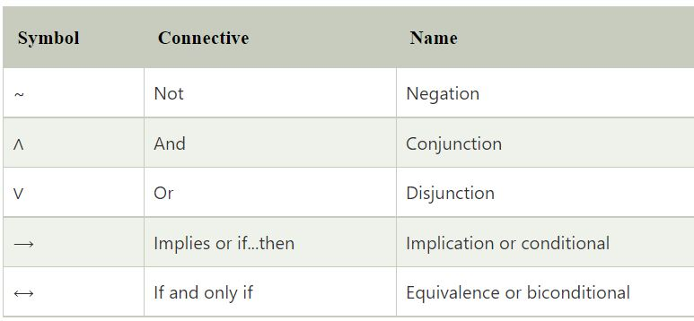
Propositional Calculus
Connectives:
Logical Connectives, we use in this are 5
And
Or
Negation
Exclusive or
Implication
Equivalence

Slide 13
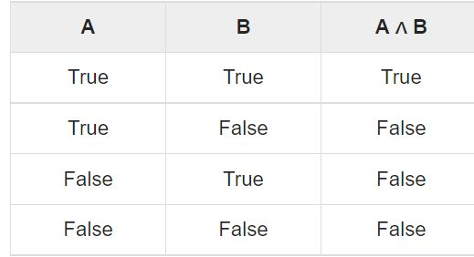
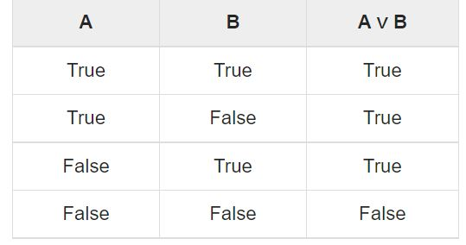
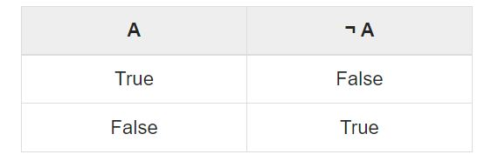
Propositional Calculus
Connectives:
Logical Connectives, we use in this are 5
And
Or
Negation
Exclusive or
Implication
Equivalence

Slide 14
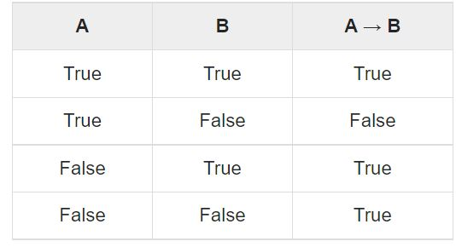
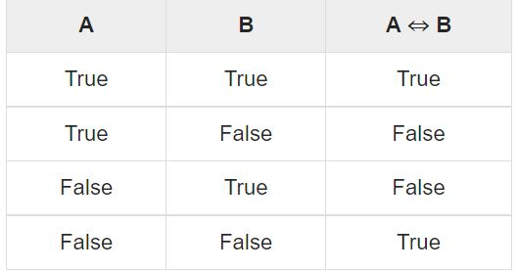
Propositional Calculus
Connectives:
Logical Connectives, we use in this are 5
And
Or
Negation
Exclusive or
Implication
Equivalence

Slide 15
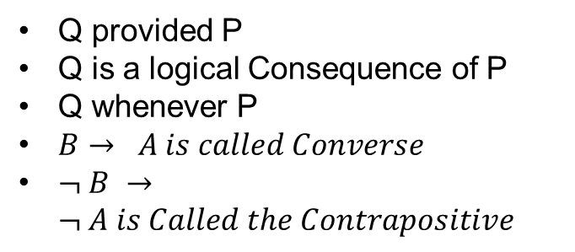
Propositional Calculus
Connectives:
Logical Connectives, we use in this are 5
And
Or
Negation
Exclusive or
Implication
Equivalence
A implies B means
A means premise, hypothesis, antecedent
B means Conclusion, Consequence
How do we Call this equation
If A, then B
A Only if B
A is sufficient condition for B
B is the necessary condition for A
Q if P
Q follows from P
Q provided P
Q is a logical Consequence of P
Q whenever P
$B→ A is called Converse$
$¬ B →¬ A is Called the Contrapositive$

Slide 16
Propositional Calculus
Connectives:
Logical Connectives, we use in this are 5
And
Or
Negation
Exclusive or
Implication
Equivalence
A is equivalent to B
How do we Call this equation
A if and only if B
A is necessary and sufficient condition for B.

Slide 17
Propositional Calculus
Well Formed formulas:
The notion of the statements are represented symbolically using symbols and its connectives.
An expression which is a string consisting of variables, parentheses, and connective symbols is called statement formula.
Not every string of these is a statement formula.
A statement formula often called well-formed formula(wff). If the formula is generated by the following rules

Slide 18
Propositional Calculus
Well Formed formulas:

Slide 19
Propositional Calculus
Truth Table:
A truth table is a table or chart used to illustrate and determine the truth value of propositions and the validity of their resulting argument.
Rules to construct the truth table.
For n variables construct n + k columns where are subset of all statement formulas (method 1) or all symbols of a formula (method 2)
For n variables we need to construct 2^{n} rows.
Represent Binary numbers from 0 to 2^{n} – 1.
Optional Replace 0 with F, and 1 with T.
Apply Truth values for each formula or symbols of a formula in proper order.
Refer the website:
https://web.stanford.edu/class/cs103/tools/truth-table-tool/

Slide 20
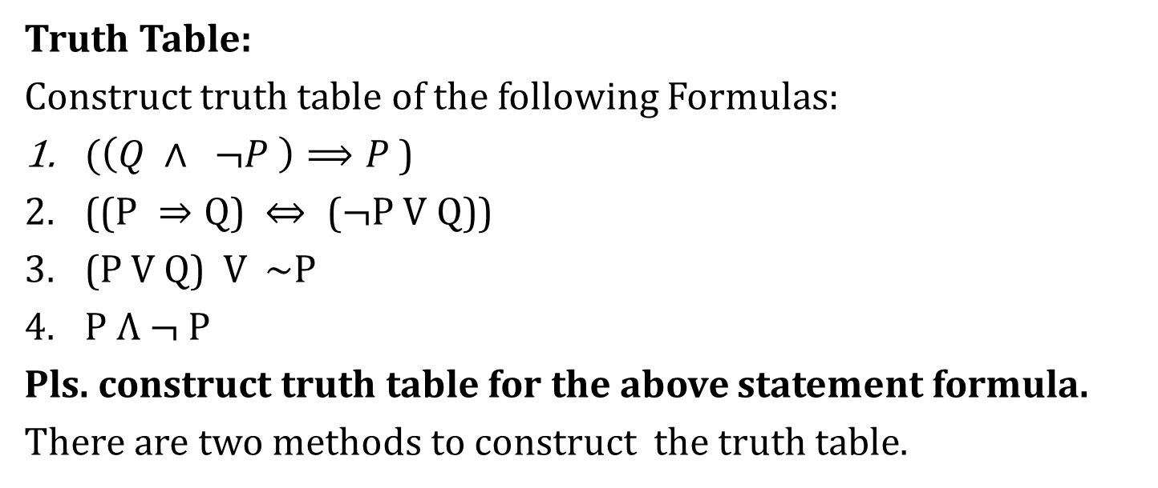
Propositional Calculus
Truth Table:
Construct truth table of the following Formulas:
$(\left(Q ∧ ¬P \right)⟹P$)
$\text{((}\text{P} ⇒Q\text{) }⇔\text{ (}¬\text{P} \text{V} \text{Q}\text{))}$
(P V Q) V ~P
$P Λ ¬ P$
Pls. construct truth table for the above statement formula.
There are two methods to construct the truth table.

Slide 21
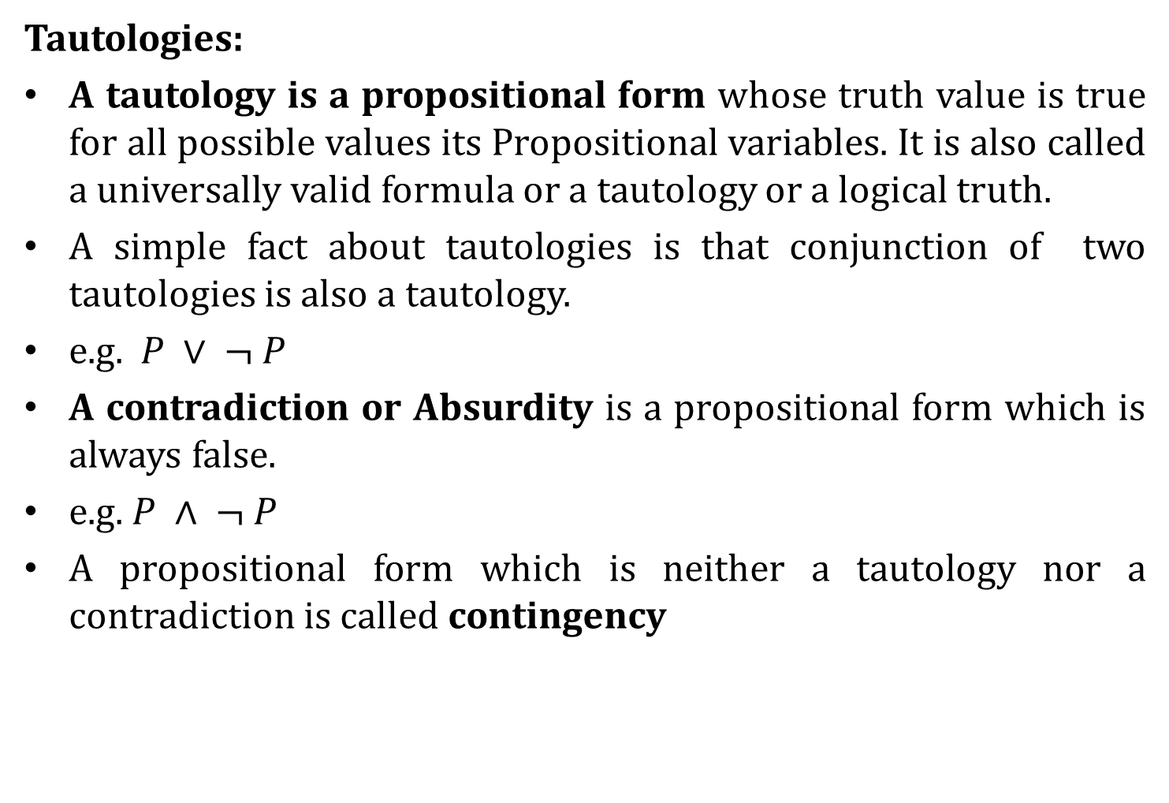
Propositional Calculus
Tautologies:
A tautology is a propositional form whose truth value is true for all possible values its Propositional variables. It is also called a universally valid formula or a tautology or a logical truth.
A simple fact about tautologies is that conjunction of two tautologies is also a tautology.
e.g. $P ∨ ¬ P$
A contradiction or Absurdity is a propositional form which is always false.
e.g. $P ∧ ¬ P$
A propositional form which is neither a tautology nor a contradiction is called contingency

Slide 22
Propositional Calculus
Tautologies:
A straight method to know whether a given formula is a tautology is to construct its truth table, which is shown in figure.

Slide 23
Propositional Calculus
Tautologies:
To identify the given formula is tautology, we use two methods
Constructing truth table.
Substituting method.
Substitution method:
A formula A is called substitution instance of another formula B if A can be obtained from B by substituting formulas for some variables of B, with the condition that same formula is substituted each time it occurs.
Note substitutions are made for the Atomic formula and never for molecular formulas.

Slide 24

Propositional Calculus
Tautologies:
The following substitution instances of $P V¬ P$are tautologies.

Slide 25
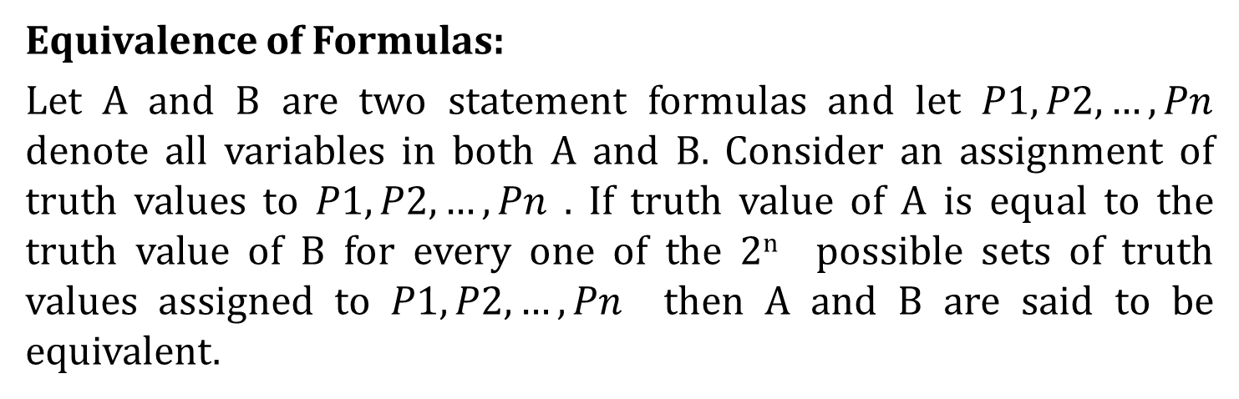
Propositional Calculus
Equivalence of Formulas:
Let A and B are two statement formulas and let $P1, P2, …, Pn$ denote all variables in both A and B. Consider an assignment of truth values to $P1, P2, …, Pn$ . If truth value of A is equal to the truth value of B for every one of the 2^{n} possible sets of truth values assigned to $P1, P2, …, Pn$ then A and B are said to be equivalent.

Slide 26
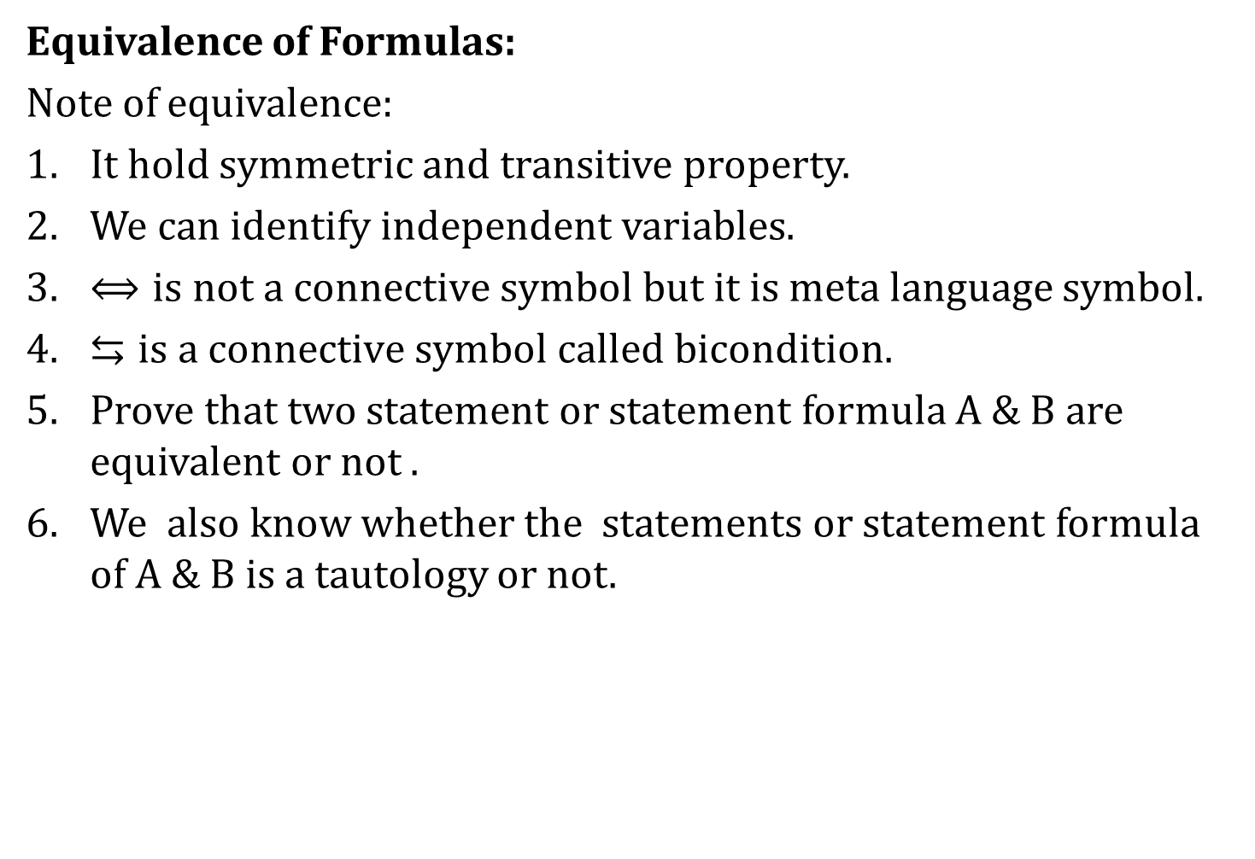
Propositional Calculus
Equivalence of Formulas:
Note of equivalence:
It hold symmetric and transitive property.
We can identify independent variables.
$⟺is not a connective symbol but it is meta language$ symbol.
$⇆is a connective symbol called bicondition.$
Prove that two statement or statement formula A & B are equivalent or not .
We also know whether the statements or statement formula of A & B is a tautology or not.

Slide 27
Propositional Calculus
Equivalence of Formulas:

Slide 28
Propositional Calculus
Equivalence of Formulas:

Slide 29
Propositional Calculus
Equivalence of Formulas:
There are two methods to check the statement formula A and B are equivalent.
Constructing truth table.
Replacement process
In replacement process, we replace any part of a statement which is itself a formula, be it atomic or molecular , by another formula.

Slide 30

Propositional Calculus
Duality Law:
We can represent any other connective like implication, bi-implication, nor, nand, xor etc. using the connectives and, or and Not .
Two formulas A and A* , are said to be duals to each other , if one can be obtained from the other by replacing $∧by ∨and ∨ by ∧.$ These connectives $∧and ∨$ are also called duals of each other.
if the formula A contains the special variables T or F, then A*, its dual is obtained by replacing T by F and F by T.

Slide 31
Propositional Calculus
Duality Law:

Slide 32

Propositional Calculus
Duality Law:
We can also state that if any two formulas are equivalent, then their duals are equivalent to each other. In other words, if A $⟺B , then$A* $⟺$ B*

Slide 33
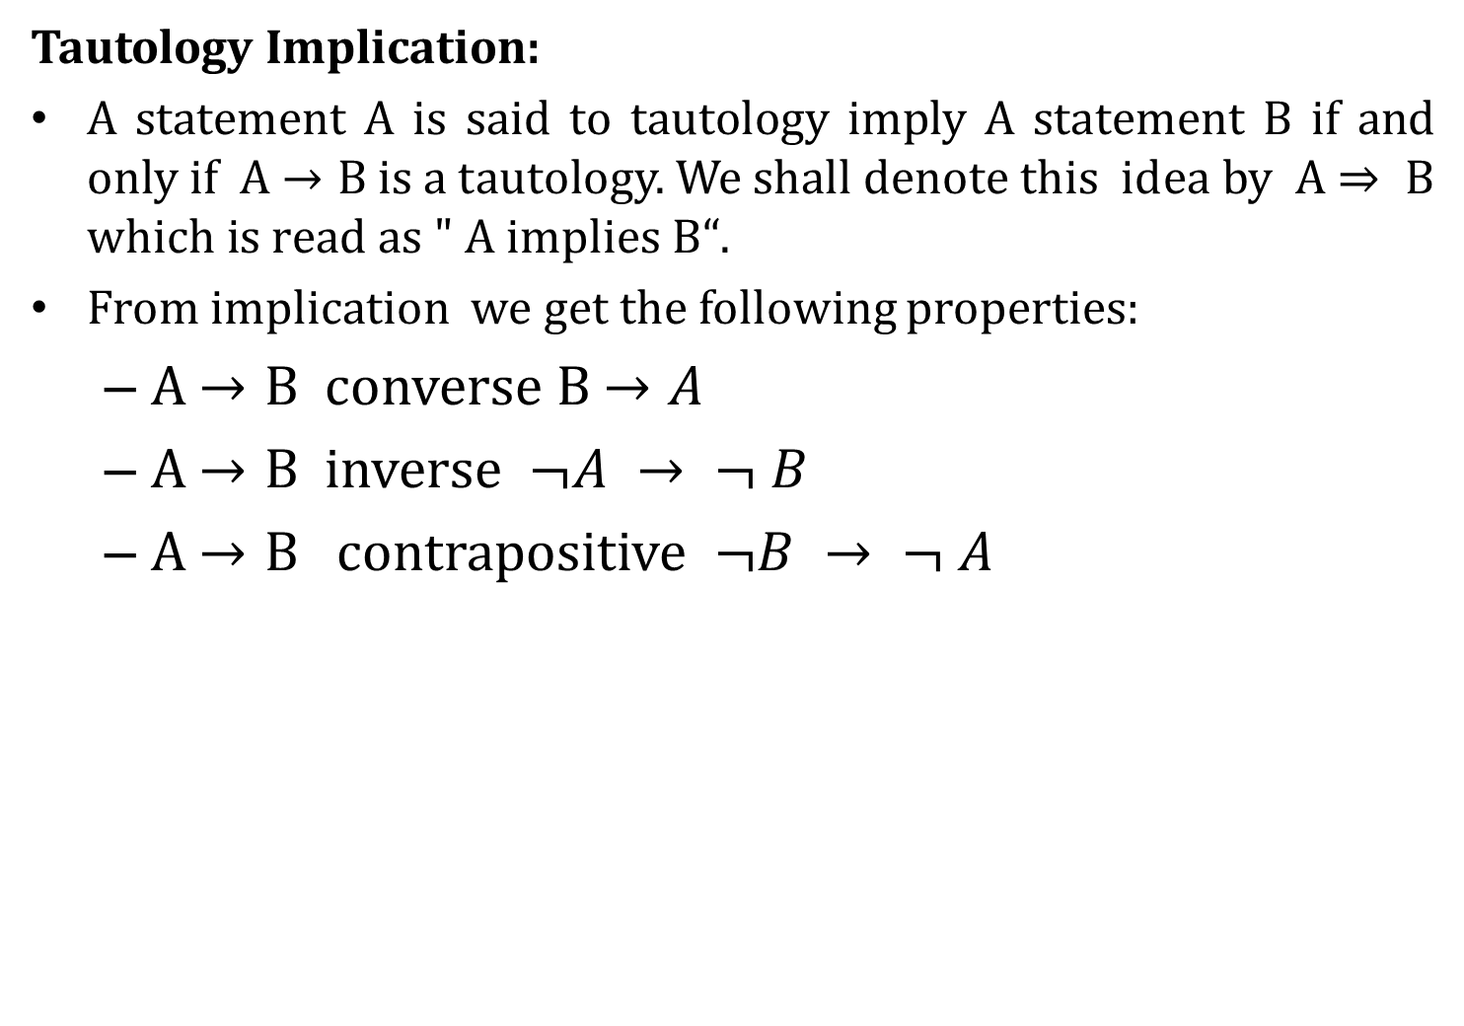
Propositional Calculus
Tautology Implication:
A statement A is said to tautology imply A statement B if and only if A $→B$ is a tautology. We shall denote this idea by A$⇒ B$ $which is read as " A implies B“$.
From implication we get the following properties:
A $→B$ converse B $→A$
A $→B$ inverse $¬A → ¬ B$
A $→B$ contrapositive $¬B → ¬ A$

Slide 34

Propositional Calculus
Tautology Implication:
A statement A is said to tautology imply A statement B if and only if A $→B$ is a tautology. We shall denote this idea by A$⇒ B$ $which is read as " A implies B“$.

Slide 35
Propositional Calculus
Tautology Implication:
How to identify whether a given statement formula is a tautology implication.
Construction the truth table.
Assuming Antecedent is true and proving consequent is true.
Assuming Consequent is False and Proving Antecedent is False.
Refer Formulas 9, 10, 11, & 12.
Important facts about implication and equivalence.
If a formula is equivalent to a tautology, then it must be a tautology.
If a formula is implied by tautology then it is a tautology.

Slide 36
Propositional Calculus
Tautology Implication:

Slide 37
Propositional Calculus
Normal Forms:
The problem of determining, in a finite number of steps, whether a given statement formula is a tautology or a contradiction or at least satisfiable is known as a decision problem.
Construction a truth table for statement calculus is easy when compare to predicate calculus.
This is not possible with aid of a computer, so another method known as reduction to normal forms

Slide 38
Propositional Calculus
Normal Forms: (Terminology)
Let Assume the word “product” in place of Conjunction and “Sum” in place of disjunctive.
A product of variables and their negations in a formula is called elementary product.
A sum of variables and their negations in a formula is called elementary sum.
Any part of the elementary sum or product which is itself an elementary sum or product is called a factor of the original elementary sum or product.

Slide 39
Propositional Calculus
Normal Forms: (Terminology)
Basic Facts about elementary sums and products.

Slide 40
Propositional Calculus
Normal Forms: (Disjunctive Normal Form)
A formula which is equivalent to a given formula and which consists a sum of elementary products is called a disjunctive normal form.

Slide 41
Propositional Calculus
Normal Forms: (Conjunctive Normal Form)
A formula which is equivalent to a given formula and which consists of a product of elementary sums is called a conjunctive normal form of a given formula

Slide 42
Propositional Calculus
Normal Forms: (Conjunctive Normal Form)

Slide 43
Propositional Calculus
Normal Forms: (Conjunctive Normal Form)

Slide 44
Propositional Calculus
Normal Forms: (Principle Disjunctive Normal Form)
Let P and Q be two statement variables. Let us construct all possible formulas which consists of conjunctions of P or its negations and conjunctions of Q or its negations.
These formulas are called minterms or Boolean Conjunctions of P and Q.

Slide 45
Propositional Calculus
Normal Forms: (Principle Disjunctive Normal Form)
From a given formula, an equivalent formula consisting of disjunctions of minterms only is known as its principle disjunctive normal form. It is also called sum-of-products canonical form
To obtain Unique normal form

Slide 46
Propositional Calculus
Normal Forms: (Principle Disjunctive Normal Form)

Slide 47
Propositional Calculus
Normal Forms: (Principle Disjunctive Normal Form)

Slide 48
Propositional Calculus
Normal Forms: (Principle Disjunctive Normal Form)

Slide 49
Propositional Calculus
Normal Forms: (Principle Disjunctive Normal Form)

Slide 50
Propositional Calculus
Normal Forms: (Principle Conjunctive Normal Form)
For a given Formula, an equivalent formula consisting of conjunctions of maxterms only is known as its principle Conjunctive form. This normal form is also called product-of-sums canonical form.
For a given number of variables, the maxterms consists of disjunction in which each variable or its negation, but not both, appears only once.
Thus maxterms are the duals of minterms.

Slide 51
Propositional Calculus
Normal Forms: (Principle Conjunctive Normal Form)

Slide 52
Propositional Calculus
Normal Forms: (Principle Conjunctive Normal Form)

Slide 53
Propositional Calculus
The Theory of inference for statement calculus:
The main function of logic is to provide rules of inference, or principles of reasoning.
The theory associated with such rules is known as inference theory.
When a conclusion is derived from a set of premises by using the accepted rules of reasoning, then such a process of derivation is called a deduction, or a formal proof.
In a formal proof, every rule of inference that is used at any stage in the derivation is acknowledge.
In most literature of reasoning, conclusions called theorems, and set of premises called axioms of the theory.
The rules of inference are criteria for determining the validity of argument.
Any conclusion which is arrived by following these rules is called a valid conclusion , and the argument is called valid argument.

Slide 54
Propositional Calculus
The Theory of inference for statement calculus:
Validity Using Truth Tables:

Slide 55
Propositional Calculus
The Theory of inference for statement calculus:
Validity Using Truth Tables:

Slide 56
Propositional Calculus
The Theory of inference for statement calculus:
Validity Using Truth Tables:

Slide 57
Propositional Calculus
The Theory of inference for statement calculus:
Rules of Inference:
To demonstrate process of derivation we will use mostly the following 2 rules. Additional rules will be discussed later.
Before proceeding the actual process of derivation, use the important implications and equivalences.

Slide 58
Propositional Calculus
The Theory of inference for statement calculus:
Rules of Inference:

Slide 59
Propositional Calculus
The Theory of inference for statement calculus:
Rules of Inference:

Slide 60
Propositional Calculus
The Theory of inference for statement calculus:
Rules of Inference:

Slide 61
Propositional Calculus
The Theory of inference for statement calculus:
Rules of Inference:

Slide 62
Propositional Calculus
The Theory of inference for statement calculus:
Rules of Inference:

Slide 63
Propositional Calculus
The Theory of inference for statement calculus:
Rules of Inference:

Slide 64
Propositional Calculus
The Theory of inference for statement calculus:
Rules of Inference:

Slide 65
Propositional Calculus
The Theory of inference for statement calculus:
Rules of Inference:

Slide 66
Propositional Calculus
The Theory of inference for statement calculus:
Rules of Inference:

Slide 67
Propositional Calculus
The Theory of inference for statement calculus:
Consistency of premises and Indirect Method of Proof
A Set of formulas H₁, H₂, … , H_{n}. is said to be consistent if their conjunction has the truth value T for some assignment of the truth values to the atomic variables appearing in H1, H2, … , Hn. Otherwise, it is considered as inconsistent.
The notion of inconsistency is used in a procedure called proof by contradiction or reductio ad absurdum or Indirect method of proof.

Slide 68
Propositional Calculus
The Theory of inference for statement calculus:
Consistency of premises and Indirect Method of Proof

Slide 69
Propositional Calculus
The Theory of inference for statement calculus:
Consistency of premises and Indirect Method of Proof

Slide 70
Propositional Calculus
The Theory of inference for statement calculus:
Consistency of premises and Indirect Method of Proof
We can use conditional proof instead of proof of contradiction.

Slide 71
Predicate Calculus
Narasimhulu M_{M. Tech.}
Assistant Professor
Department of Computer Science & Engineering

Slide 72
Predicate Calculus
In Propositional calculus, It is not possible to express the fact that any two atomic statement have some features in common.
The logic based upon the analysis of predicates in any statement is called predicate logic.
Predicate:
In a statement, a part of it can be shared by one or more individuals can be called as predicate.
For Eg:
John is a bachelor
Smith is a bachelor
Some other examples to be considered
All human beings are mortal
John is a human being
Therefore, John is a mortal.

Slide 73
Predicate Calculus
Predicates are represented as Q(p) where Q is a predicate and p a subject.
Eg: B(j), B(s)
A predicate requiring m names (m > 0) is called an m-place predicate.
Statement Functions, Variables and Quantifiers:
Let H be the predicate “is a mortal”, b the name “Mr. Brown”, c “ Canada” and S “A Shirt” then H(b), H(c) and H(s) all denote statements. If we use x as place holder instead of names of object then H(x) is called a Statement function.
Thus a statement function is an expression having Predicate Symbol and one or multiple variables. This statement function gives a statement when we replaced the variables with objects. This replacement is called substitution instance of statement function.

Slide 74
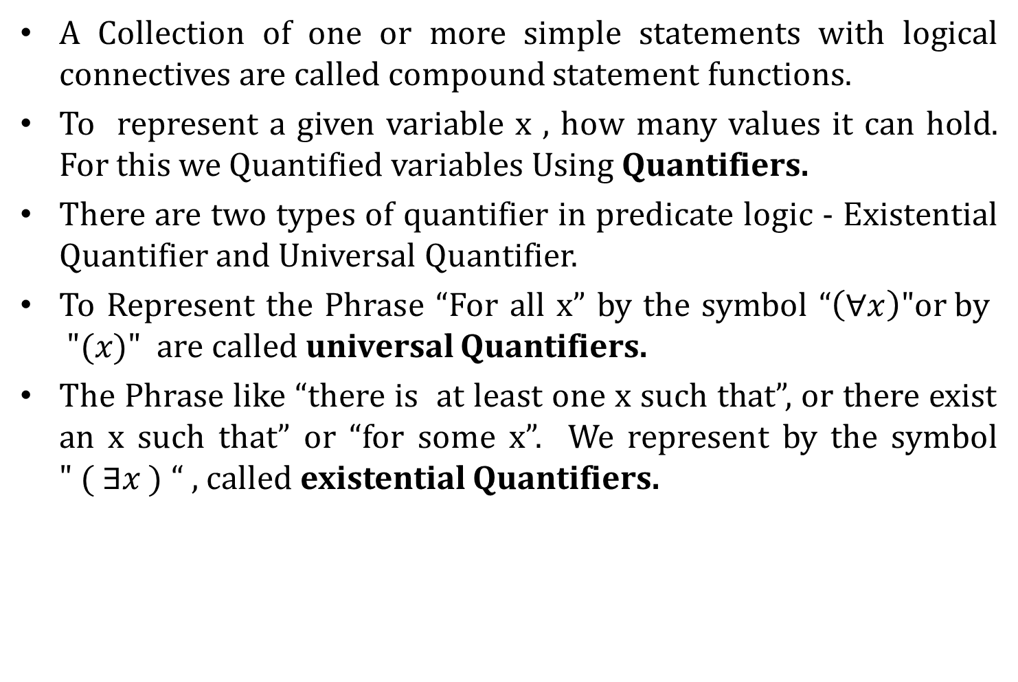
Predicate Calculus
A Collection of one or more simple statements with logical connectives are called compound statement functions.
To represent a given variable x , how many values it can hold. For this we Quantified variables Using Quantifiers.
There are two types of quantifier in predicate logic - Existential Quantifier and Universal Quantifier.
To Represent the Phrase “For all x” by the symbol “$\left(∀x\right)\text{"}\text{or} \text{by} "(x)"$ are called universal Quantifiers.
The Phrase like “there is at least one x such that”, or there exist an x such that” or “for some x”. We represent by the symbol $" ( ∃x )$ “ , called existential Quantifiers.

Slide 75
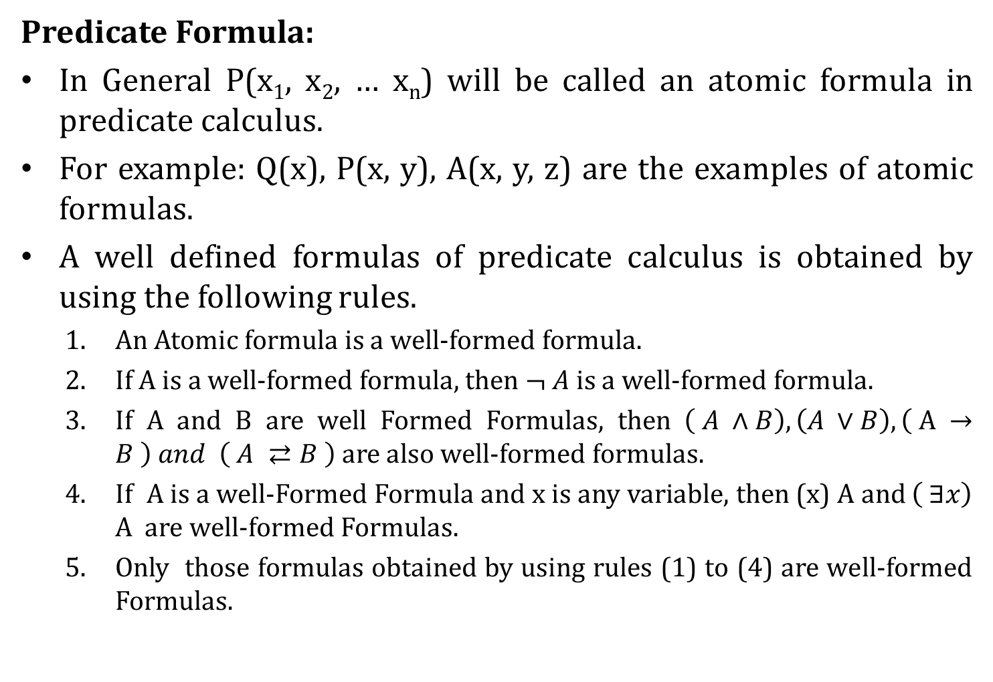
Predicate Calculus
Predicate Formula:
In General P(x₁, x₂, … x_{n}) will be called an atomic formula in predicate calculus.
For example: Q(x), P(x, y), A(x, y, z) are the examples of atomic formulas.
A well defined formulas of predicate calculus is obtained by using the following rules.
An Atomic formula is a well-formed formula.
If A is a well-formed formula, then $¬ A$ is a well-formed formula.
If A and B are well Formed Formulas, then $\left( A ∧B\right), \left(A ∨B\right), \left( A →B \right) and \left( A ⇄B \right)$ are also well-formed formulas.
If A is a well-Formed Formula and x is any variable, then (x) A and $\left( ∃x\right)$ A are well-formed Formulas.
Only those formulas obtained by using rules (1) to (4) are well-formed Formulas.

Slide 76
Predicate Calculus
Free and Bound Variables:
Consider a Predicate formula having a part in form of (∃ x) P(x) of (x)P(x), then such part is called x-bound part of the formula. Any occurrence of x in x-bound part is termed as bound occurrence and any occurrence of x which is not x-bound is termed as free occurrence.
Examples

Slide 77
Predicate Calculus
Free and Bound Variables:

Slide 78
Predicate Calculus
Universe of Discourse:
We can limit the class of individuals/objects used in a statment. Here limiting means confining the input variable to a set of particular individuals/objects. Such a restricted class is termed as Universe of Discourse/domain of individual or universe.

Slide 79
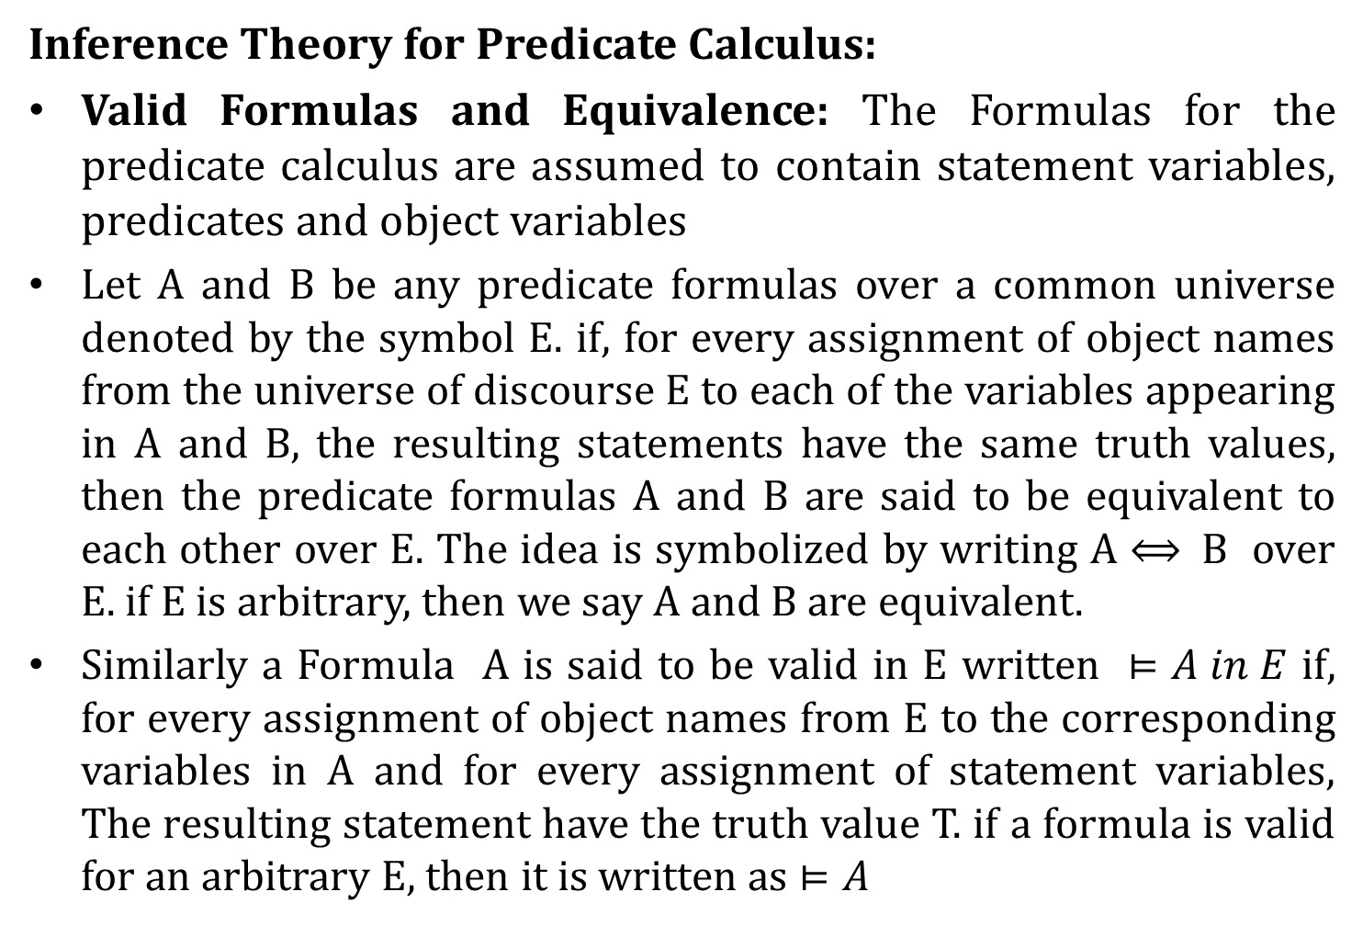
Predicate Calculus
Inference Theory for Predicate Calculus:
Valid Formulas and Equivalence: The Formulas for the predicate calculus are assumed to contain statement variables, predicates and object variables
Let A and B be any predicate formulas over a common universe denoted by the symbol E. if, for every assignment of object names from the universe of discourse E to each of the variables appearing in A and B, the resulting statements have the same truth values, then the predicate formulas A and B are said to be equivalent to each other over E. The idea is symbolized by writing A $⟺$B over E. if E is arbitrary, then we say A and B are equivalent.
Similarly a Formula A is said to be valid in E written $⊨A in E$ if, for every assignment of object names from E to the corresponding variables in A and for every assignment of statement variables, The resulting statement have the truth value T. if a formula is valid for an arbitrary E, then it is written as $⊨A$

Slide 80
Predicate Calculus
Inference Theory for Predicate Calculus:
The determination of validity of a formula by the truth table would involve examination of all possible universe which is impossible.
Formulas of the predicates calculus that involve quantifiers and no free variables are also formulas of statement calculus. Therefore substation instance of all tautologies by these formulas yield any number of special tautologies.

Slide 81
Predicate Calculus
Inference Theory for Predicate Calculus:
In general, a tautology of the statement calculus remains a valid formula of the predicate of the predicate calculus when prime formulas are substituted for statement variables through out the formula.

Slide 82
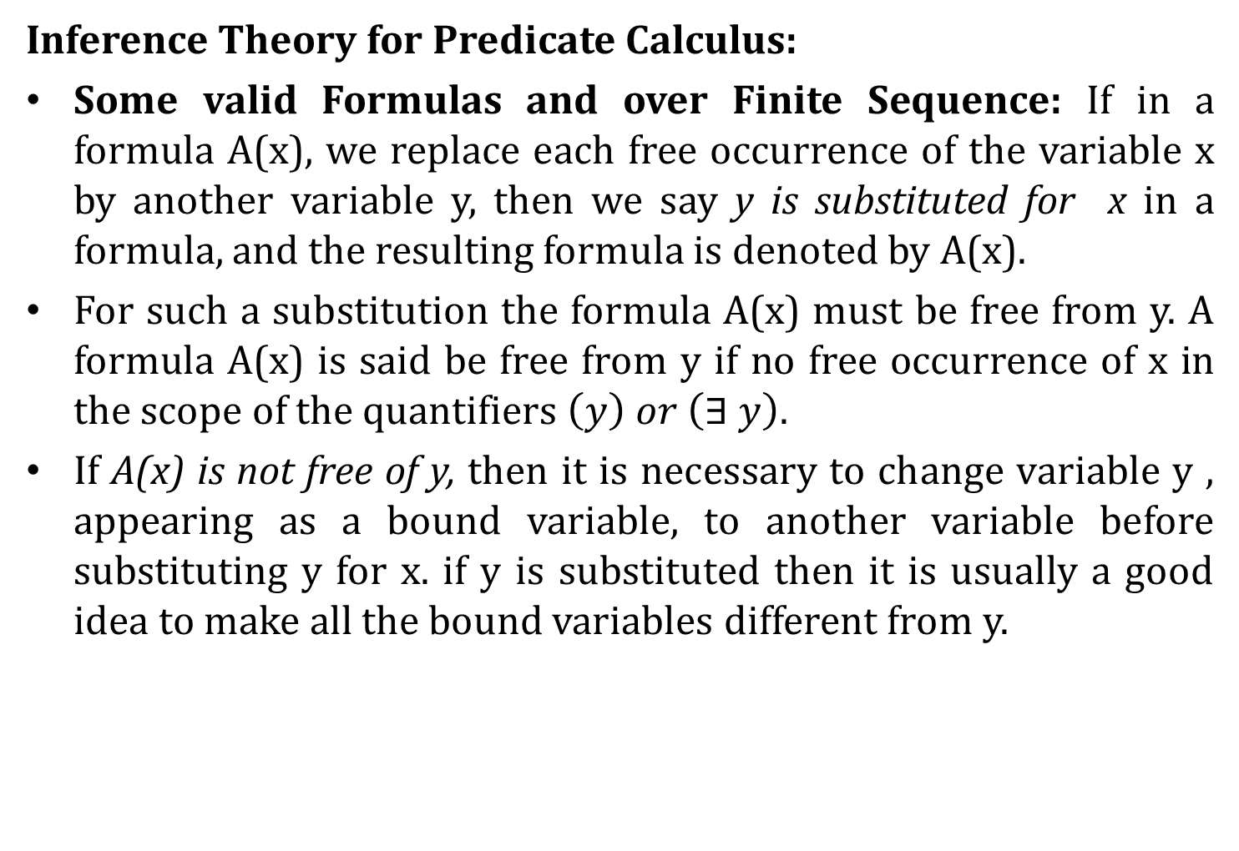
Predicate Calculus
Inference Theory for Predicate Calculus:
Some valid Formulas and over Finite Sequence: If in a formula A(x), we replace each free occurrence of the variable x by another variable y, then we say y is substituted for x in a formula, and the resulting formula is denoted by A(x).
For such a substitution the formula A(x) must be free from y. A formula A(x) is said be free from y if no free occurrence of x in the scope of the quantifiers $\left(y\right) or \left(∃ y\right).$
If A(x) is not free of y, then it is necessary to change variable y , appearing as a bound variable, to another variable before substituting y for x. if y is substituted then it is usually a good idea to make all the bound variables different from y.

Slide 83
Predicate Calculus
Inference Theory for Predicate Calculus:

Slide 84
Predicate Calculus
Inference Theory for Predicate Calculus:
Let the universe of Discourse is Finite and is denoted by S = { a₁, a₂, . . . a_{n}}

Slide 85

Predicate Calculus
Inference Theory for Predicate Calculus:
Special Valid Formulas Involving Quantifiers:
Universal Specification ( US) : $\left(x\right) A\left(x\right)⟹A(x)$
Universal Generalization (UG): $A\left(x\right)⟹\left(x\right) A(x)$
Existential Specification ( ES): $\left(∃x\right) A\left(x\right)⟹A(y)$
Existential generalization (EG): $A\left(y\right)⟹\left(∃x\right) A(x)$

Slide 86
Predicate Calculus
Inference Theory for Predicate Calculus:
Special Valid Formulas Involving Quantifiers:

Slide 87
Predicate Calculus
Inference Theory for Predicate Calculus:
Theory of Inference for Predicate Calculus:
Use rule P, T, CP of Statement Calculus and Rule US, ES, UG and EG.

Slide 88
Predicate Calculus
Inference Theory for Predicate Calculus:

Slide 89
Predicate Calculus
Inference Theory for Predicate Calculus:

Slide 90
Predicate Calculus
Inference Theory for Predicate Calculus:

Slide 91
Predicate Calculus
Inference Theory for Predicate Calculus:

Slide 92
Predicate Calculus
Inference Theory for Predicate Calculus:

Slide 93
Predicate Calculus
Inference Theory for Predicate Calculus:

Slide 94
Predicate Calculus
Inference Theory for Predicate Calculus:

Slide 95
Predicate Calculus
Inference Theory for Predicate Calculus:
Formulas Involving more than one Quantifier:
The Possibility ways P(x,y) can be represented Using Quantifiers:

Slide 96
Predicate Calculus
Inference Theory for Predicate Calculus:
Formulas Involving more than one Quantifier:
From the meaning of Quantifiers The following Formulas are derived:

Slide 97
Predicate Calculus
Inference Theory for Predicate Calculus:
Formulas Involving more than one Quantifier:
Graphical Representation of the above Formulas:

Slide 98
Predicate Calculus
Inference Theory for Predicate Calculus:
Formulas Involving more than one Quantifier:

Slide 99
End of Unit-1

